Slide 1
Comms Utility
1/21/2021
Andrew Hellrigel

Slide 2
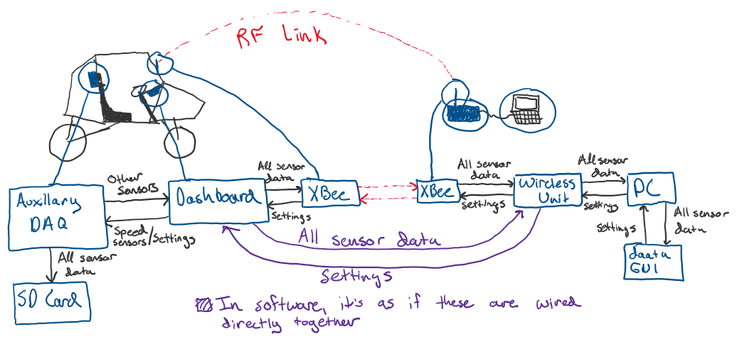
Problem it is trying to solve

Slide 3
Problem it is trying to solve cont.
Current method involves implementing a specific solution for each node
Does not scale well (or at all really)
Currently hard-code new sensors when we add them
In past when we’ve removed sensors, we just send garbage data because it is faster than just removing the sensor and messing up the structure
Takes a lot of time to implement and test communication between nodes and is very prone to errors
Code is not reusable

Slide 4
High level goals: modularity/future-proof
Try to make the system “smart” to reduce the changes that need made on each node
Ex. If I remove a sensor on the aux daq unit, I should only have to change the code on that unit and the rest of the network should realize that the sensor is now missing so it can update its stuff accordingly
System should scale well to add/remove “nodes” as necessary
Should be trivial to add/remove sensors
Base code shouldn’t need changed and it should work for future years/systems
Baud rates and communication rates can be changed easily
Support at least 200 Hz data communication

Slide 5
Current limiting factor
Xbee communication rate is only 250 Kb/s (250,000 baud)
250,000 baud / 200 Hz communication rate = 1250 bits/packet
1250 bits / (8 bits/byte) = 156 bytes/packet max theoretical
1 bytes is needed for read/write set and 8 bytes are needed for end code -> 156 – 9 = 147 bytes/packet of sensor data.
Note that this is theoretical, but we can probably get close to this size of packet
Also note that Teensy FIFO buffers are 64 bytes by default. Things are generally easier if we stay at a packet size of less than 64 bytes, but this can be changed if we go above 64/bytes per packet. Otherwise the code will be blocking while it waits for the FIFO buffer to be available again.
Teensy 4.0 has a max baud rate of 4Mb/s for reference

Slide 6

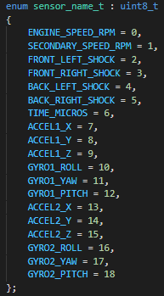
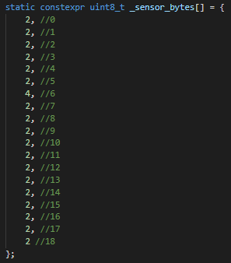

How does it work? (Adding new sensors)
_sensor_is_sending -> For sensors that are connected to unit that you want to send to other units
_sensor_is_receiving -> The array which says what sensor data is being received, these are port specific (9 serial ports on Teensy)
_data_store -> This is a temp array to store incoming data before it is read from main code (Max size of a single “sensor” is 12 bytes).
_has_new_data -> This array says if new data for a specific sensor has been received since last read

Slide 7
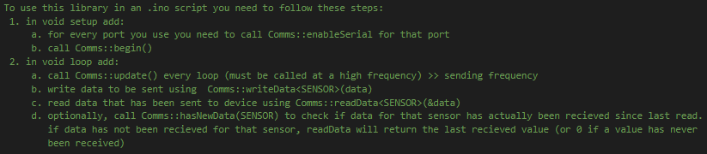
How does it work? (Using in main code)
Ex. On Dashboard you might call “Comms::writeData<ENGINE_SPEED_RPM>(engine_rpm)”
Right now ENGINE_SPEED_RPM is a 2-byte variable so if engine_rpm is not 2 bytes it will fail at compile time
Ex. On Dashboard if aux daq unit is connected you might call “Comms::readData<FRONT_LEFT_SHOCK>(&fl_lds)”
Similarly, fl_lds must be a 2-byte variable (i.e. uint16_t) or it will fail compile time

Slide 8
Assumptions being made
You will never both read and write the same sensor (so _data_store can work as temp storage for both)
You will also never receive data for the same sensor from two different sources
If you are sending data somewhere and have multiple nodes connected, you will want to send the same data to every node and not some sensors to one node and some sensors to another
A “sensor” does not have to be a physical sensor. For example, in the GUI when you say start collecting data, that can be sent out to all nodes through a “sensor” called COLLECT_DATA which is either ‘0’ or ‘1’. Same can be done for other settings we decide to add.

Slide 9
Technical details (typical flow diagram)
Powered Off
Know receiving ports
Don’t know receiving data
Know sending ports
Know sending data
Send settings request on receiving ports
Send settings on sending ports then start sending data
Power on
Get a settings array on a receiving port
Don’t know receiving ports
Don’t know receiving data
Don’t know sending ports
Don’t know sending data
Do nothing
Know receiving ports
Know receiving data
Know sending ports
Know sending data
Do nothing on receiving ports
Send data on sending ports
Get a settings request on a sending port
Go through void setup()
Know receiving ports
Don’t know receiving data
Know sending ports
Don’t know sending data
Send settings request on receiving ports
Do nothing on sending ports
Go through one loop of void loop()
Know receiving ports
Don’t know receiving data
Know sending ports
Know sending data
Send settings request on receiving ports
Do nothing on sending ports

Slide 10
Edge case (Settings have been sent but weren’t complete)
The settings were already sent to a device, but a new call to Comms::writeData<SENSOR>(data) has been made with a new SENSOR, which is what updates the settings array (i.e. _sensor_is_sending)
In this case just set a flag (_has_updated_settings) for that port and do nothing

Slide 11
Edge case (Data has stopped being received)
No longer receiving data could be due to a few reasons
Out of range or poor connection (i.e. packet loss)
The host has new settings and has stopped sending data
The host was powered off / broke / other
In all cases, after a predetermined amount of time (maybe like if data has not been received for > 20ms or something which would mean it has lost at least 4 packets), just start sending a settings request again as if there was never a connection in the first place
A settings request should just be a ‘0’ followed by the end code. If the first byte in a ‘packet’ is a ‘0’ then it is always a settings request, otherwise, if it is a ‘1’, then what follows is data being sent
This is needed for two-way communication

Slide 12
Edge case (Only part of a packet was received)
This could occur if we went out of range and came back in range quickly
This is where the end code comes in, if the size of the packet received was not the size that you were expecting (based on the settings array), then you throw that packet away
This is a specific edge case that is unlikely but should still be handled. If we go out of range for longer than our threshold then we will start sending a settings request. When we come back in range, if a packet gets sent (because the sender doesn’t know it is out of range, only the receiver), the receiver could interpret that packet as the settings. We need to make sure that there are checks to make sure that a settings array is valid, and if not then keep requesting the settings until a valid array is sent
This shouldn’t be too difficult since a settings matrix should just be a bunch of ‘0’s and ‘1’s with the end code
Maybe the first byte in a settings array should be a ‘2’ instead of a ‘1’ so that it is separate from a data send

